Slide 1
OBJECT ORIENTED PROGRAMMING IN C++
[UNIT-IV]

Slide 2
Learning Objectives
Generic Programming
Types of templates
Class template
Multiple parameters in class templates
Function template
Overloading of template functions
Non type template arguments

Slide 3
What is generic programming
It is an approach where generic types are used as parameters in algorithms so that they work for a variety of data types and DS.
It eliminates code duplication and makes prog development easy and manageable.(advantage)
Feature of C++ is templates which helps to eliminate redundant coding.
Templates support generic programming, which allows you to develop reusable software components such as functions, classes, etc., supporting different data types in a single framework.
A template declared for functions are called function templates and those declared for classes are called class templates.
Eg:- A function template for swap can be used to swap values for different data types.

Slide 4
Templates
A template is one of the features added to C++ recently. It is a new concept which enables the programmer to define generic classes and functions; thus provides support for generic programming.
Generic programming is an approach, where generic types are used as parameters in algorithms so that they work for a variety of suitable data types and data structures.
A template can be used to create a family of classes or functions. For example, a class template for an array class would enable us to create arrays of various data types such as int array and float array.
Similarly, we can define a template for a function, say multiply(), that would help us create various versions of multiply() for multiplying int, float and double type values.

Slide 5
Templates
A template can be considered as a kind of macro.
When an object of a specific type is defined for actual use, the template definition for that class is substituted with the required data type.
Since a template is defined with a parameter that would be replaced by a specified data type at the time of actual use of the class or function. Therefore the templates are sometimes called parameterized classes or functions.

Slide 6
Contd….
To define a vector that can store an array of float values.
template <class T>
class vector
{ private: T*v; int size;
public: vector(int m){ v=new T[size=m;]
for (int i=0; i<size; i++) v[i]=0;}
vector (T *a, int size) {for (int i=0; i<size; i++) v[i]=a[i];}
T operator*(vector &y){T sum=0; for (int i=0; i<size; i++)
sum+=this->v[j]*y->v[i];
return sum;
}}

Slide 7
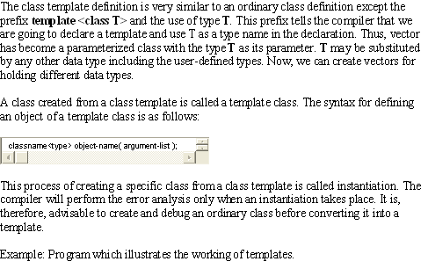
Contd…

Slide 8
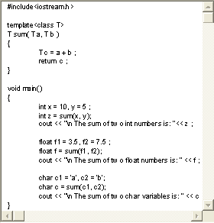
Contd…

Slide 9
WITHOUT USING TEMPLATES
int sum(int x,int y)
{
int z;
z=x+y;
return z;
}
float sum(float x,float y)
{
float z;
z=x+y;
return z;
}

Slide 10
USING TEMPLATES
template <class T>
T sum(T x,T y)
{
T s;
s=x+y;
return T;
}
void main()
{
sum(2,3);
sum(5.7,8.9);
}

Slide 11
Function templates
Allows a single function to be operated upon multiple data types. syntax:
template<class T,…….>
Return type fun_name(arg)
{
Body of function
}
The keyword 'class' above simply means that the identifier fun_name will stand for a datatype
keyword
Template type arguments
Atleast one argument of type template

Slide 12
Working of template functions
Function called normally like any other function with parameters of any data type.
When compiler encounters a call , it identifies the data types of the parameters and creates a function internally and makes a call to it.
All future invocations to function template WITH THAT DATA TYPE refer to it.
Internal function unknown to user.

Slide 13
Usage of template argument
Every template argument specified in template argument list must be used as generic data type for definition of formal parameters.
template < class T>
void test(int x) //error: T not used as argument
{
T temp;
test statements;
}

Slide 14
Use of partial no of generic data types or leaving only one argument unused in the argument list also results in an error.
template <class T, class U>
void test(T x) //error: U is not used in argument
{
U try;
statements..;
}

Slide 15
Not specifying any argument to be used as generic data types ,if one or more arguments are specified in the template argument list also leads to an error.
Ex:
Template<class T>
T pop(void) //error:T not used as an argument
{
return --stack;
}

Slide 16
All the formal parameters need not be of generic type, provided all the template arguments are specified.
Ex:
template <class T>
void test(T x, int z) //no error
{
function body
}

Slide 17
Function vs function template
Function templates not suitable for handling all data types.
Hence it is necessary in certain cases to overload function templates for specified data types.
Eg:
max(str1,str2)
Compares address of strings rather than strings.
If a program has both function template and a normal function, compiler first selects normal function if it matches the requested data type otherwise creates a function using template function.

Slide 18
Bsearch using template function
#include<iostream.h>
template<class T>
int bsea(T data[],T ele, int low , int high)
{
if(low>high) return -1;
int mid=(low+high)/2;
if(ele>data[mid])
return bsea(data,ele,low,mid-1);
else
return bsea(data,ele,mid+1,high);
return mid;
}
Main()
{
int ele,size,num[25],index;
Cout<<“program to search integer elements…”<<endl;
cout<<“how many elements?”; cin>>size;
cout<<“\nEnter sorted array:”;
For(int i=0;i<size;i++)
cin>>num[i];
Cout<<“Enter element to be searched”;
Cin>>ele;
If(index=bsea(num,ele,0,size))==-1)
cout<<“Element found at position:”<<index;
}

Slide 19
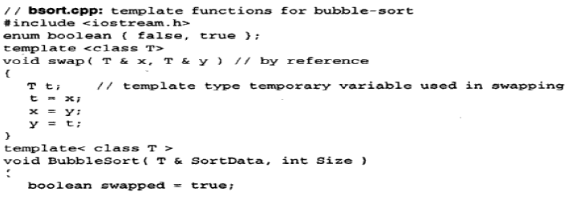
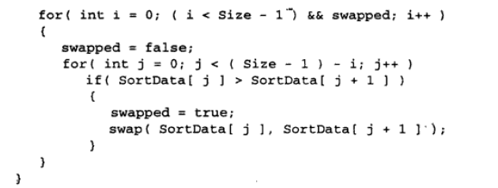

Slide 20
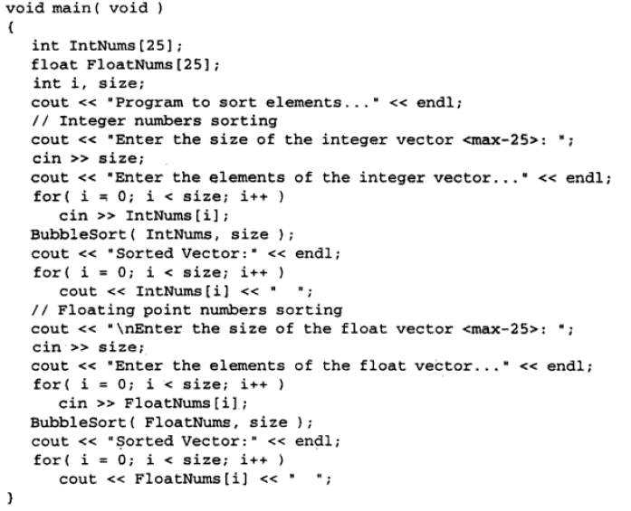

Slide 21
Function Template Overloading
A template function may be overloaded either by template functions or ordinary functions. In such cases, the overloading resolution is accomplished using following steps:
Call an ordinary function that has an exact match.
If a match for an ordinary function is not found, call a template function that could be created with an exact match.
An error is generated if no match is found. Note that no automatic conversions are applied to arguments on the template functions. The program shows how a template function is overloaded with an explicit function.

Slide 22
Member Function Template
When we created a class template for vector, all member functions were defined inline. However, this is not necessary. They could be defined outside the class as well
However, member functions of the template class themselves are parameterized by the type argument (to their template classes) and therefore these functions must be defined by the function templates as follows:
template <class T>
return –type class name <T>:: function-name(arguments)
{}

Slide 23
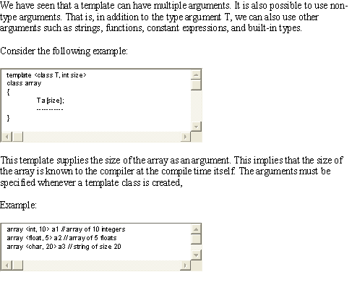
Non-Type Template Arguments

Slide 24
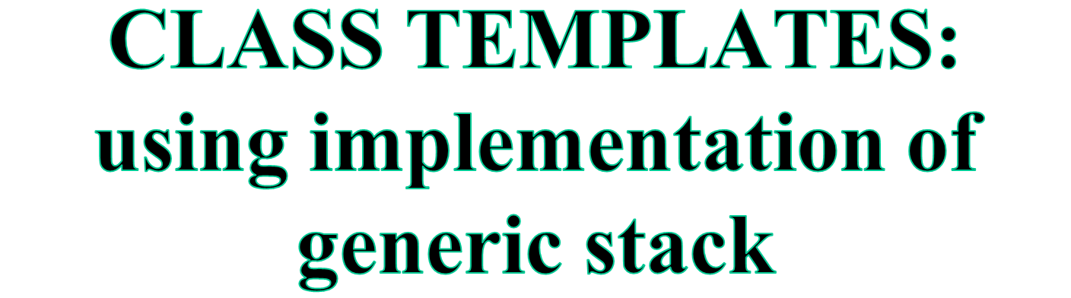

Slide 25
WHAT ARE TEMPLATES
Templates are a feature of the C++ programming language that allow functions and classes to operate with generic types.
This allows a function or class to work on many different data types without being rewritten for each one.
USES
Templates allow functions and classes to be parameterized so that the type of data being operated upon (or stored) is received via a parameter.
Templates provide a means to reuse code — one template definition can be used to create multiple instances of a function (or class), each operating on (storing) a different type of data.
The template mechanism is important and powerful. It is used throughout the Standard Template Library (STL) to achieve genericity

Slide 26
Class Templates
Much as function templates allow argument types to be parameterized, class templates allow us to parameterize the types of:
  member variables
  arguments of member functions & constructors
  return values of member functions
Conceptually, templates are a lot like macros, just without the unpleasant side effects.
  When you see a template, or use a template, think “text substitution” and you’ll be close

Slide 27
Template Instantiation
A template definition is a recipe that the compiler can use to generate a function (or a class, more on that later)
The compiler will not use this recipe unless/until you instantiate the template.
  At that point, the compiler goes and performs the text substitution you asked for, and then compiles the newly generated function as if you’d written that function yourself.
What happens if I instantiate the same template multiple different ways?
  Well, with function overloading, we just get two or more functions with the same name, but with different arguments!

Slide 28
Example (template definition)
template <class T>
T findMax(T x, T y) {
if (x < y) { return y; }
else { return x; }
}
“T” is the template parameter. Since the “T” is specified as a “typename” (i.e., the name of some type), then “T” can be replaced by any type (e.g., “int” or “string”). T can NOT be replaced by any arbitrary text, just by a type.
We have “defined” this template, which means the compiler now knows the recipe. But there is no machine code for the max function yet. The compiler won’t actually compile the max function until we instantiate it.
  The compiler does do some preliminary syntax checking, so you can get compiler errors in your template definitions even if you don’t instantiate them.

Slide 29
Simple Template Functions
template <class T>
T findMax(T x, T y) {
if (x > y) { return x; }
else { return y; }
}
int main(void) {
int x = 0;
cout << findMax(x, ++x); // prints 1
cout << x; // prints 1
string s = “hello”;
string t = “world”;
cout << findMax(s, t); // prints “world”
}

Slide 30
Template Classes
C++ also provides template classes.
Virtually any “data structure” (AKA “collection”, AKA “container”) will be implemented in C++ as a template
  The type of data stored in the structure is really not at all relevant to the data structure itself.
Template classes get “defined” and “instantiated” in analogous ways to template functions with the following caveats
  The compiler will never guess at the template argument for a template class, you must always explicitly tell the compiler “what T is”.
  Classes cannot be “overloaded”, but the compiler will permit you to instantiate the same template class in multiple ways.
    Each distinct instantiation results in a completely distinct class! (with its own copy of the static data members, for example).
  The member functions in a template class are template functions (oh, how confusing!)

Slide 31
Class Templates Syntax
For template class declaration:
To create an object of template class
For the implementation of the methods outside the class, the syntax is:
For the implementation of the constructors outside the class, the syntax is:
template<class T> class class_name{ … };
Class_name <type> ob;
template<class T> return_type
className<T>::methodName(parameter-list){……}
template<class T>
className<T>:: className(parameter-list){……}

Slide 32
Template class functions
  Declared normally, but preceded by template<class T>
    Generic data in class listed as type T
  Binary scope resolution operator used
  Template class function definition:
  template<class T>
  MyClass< T >::MyClass(int size)
  {
  myArray = new T[size];
  }
    Constructor definition - creates an array of type T

Slide 33
Diff b/w class template and template class
Class template is a template used to generate template classes.
template <typename T>
class cTemplate {
int member;
};
Template class is an instance of a class template.
cTemplate<int> cti;

Slide 34
More than 1 Generic Data type
For template with more than one generic data type.
To create objects of this class
template<class T1,class T2> class class_name{ … };
Class_name<datatype,datatype> ob;

Slide 35
USING STACK EG.

Slide 36
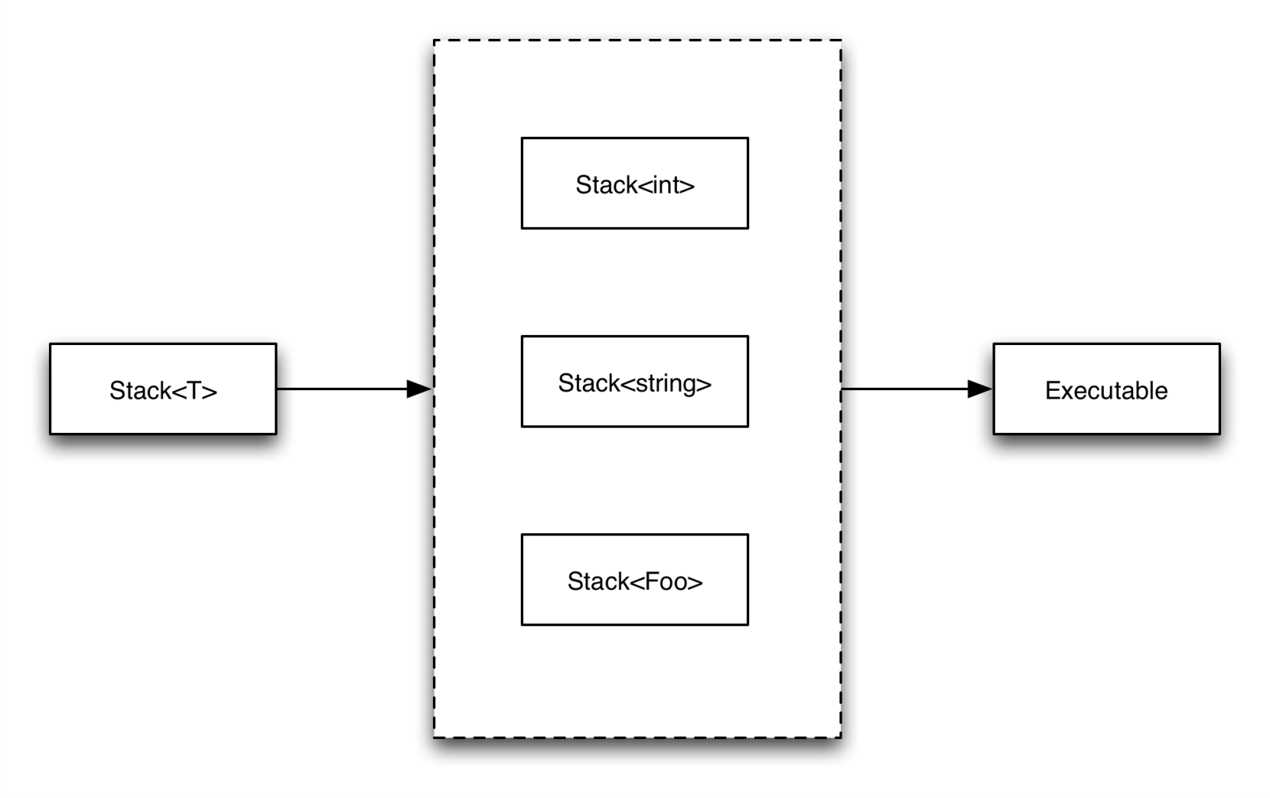
Compile-time Code Generation
Notes:
Multiple instantiations for the same type from different compilation units (if any) are merged by the linker.

Slide 37
Example:
A Generic Stack
Operations:
pop
push
empty
full
initialize
destroy
top
...
...
...
...
bottom

Slide 38
A Stack of Integers
class Stack {
int* top, bottom;
int size;
public:
Stack(int);
bool push(int);
bool pop(int&);
bool empty();
bool full();
~Stack();
};

Slide 39
A Class Template
typedef enum { false = 0, true = 1 } Bool;
template <class T> class Stack {
T *top, *bottom;
int size;
public:
Stack(int);
bool push(const T&);
bool pop(T&);
bool empty();
bool full();
~Stack():
};

Slide 40
Class implementations
template <class T>
Stack<T> :: Stack(int sz)
{
size = sz;
top = bottom = new T [sz];
}
template <class T>
bool Stack<T> :: push(const T& x)
{
if (full()) return false;
*top++ = x;
return true;
}
template <class T>
bool Stack<T> :: empty()
{
if (top == bottom)
return true;
return false;
}
template <class T>
bool Stack<T> :: pop(T& x)
{
if (empty()) return false;
x = *--top;
retrun true;
}

Slide 41
Cont.
template <class T>
Stack<T> :: ~Stack()
{
delete [] bottom;
}
template <class T>
bool Stack<T> :: full()
{
if (top-bottom >= size)
return true;
return false;
}

Slide 42
Using Stack Template
Void main()
{
Stack<int> si(100);
Stack<char> sc(20);
Stack<float> sf(25);
}

Slide 43
Function Template Overloading
You can define multiple functions and function templates with the same name
The “best match” will be used
You can also overload a function template by having a different number of template parameters

Slide 44
template<class T>
Void print( T data )
{
Cout<<data<<endl;
}
Template <class T>
Void print(T data, int nTimes)
{
For (int i=0;i<nTimes;i++)
Cout<<data<<endl;
}
Void main()
{
print(1);
Print(19.88);
Print(5,80);
Print(“mca 2nd sem “,11);
}

Slide 45
Advantages of templates
One C++ Class Template can handle different types of parameters.
Compiler generates classes for only the used types. If the template is instantiated for int type, compiler generates only an int version for the c++ template class.
Templates reduce the effort on coding for different data types to a single set of code.
Testing and debugging efforts are reduced.

Slide 46
Conclusion
Templates allow us to generate a family of classes or a family of functions to handle different data types.
It eliminates code duplication for different types and thus makes program development easier, faster and more manageable.
We can use multiple parameters in both the templates.
We may also use non-type parameters such as basic or derived data types as arguments templates.

Slide 47
Summary
C++ correspondence with OOPS does not limit to abstraction and encapsulation only, it also implements another crucial feature of inheritance, polymorphism and templates. All these features simulate their relations with real-world-models.
While inheritance facilitates code reusability, polymorphism is the ability to access different implementation of the same function and operator during compile time and run time and template supports the concept of generic programming.

Slide 48
Standard Template Library (STL)

Slide 49
Learning Objectives
Software Evolution
Standard Templates
Standard Template Library
Containers
Types of Containers
Algorithms
Iterators
Functors

Slide 50
Introduction
In order to help the C++ users in generic programming, Alexander Stepanov and Meng Lee of Hewlett Packard developed a set of general-purpose templatized classes (data structures) and functions (algorithms) that could be used as a standard approach for storing and processing of data.
The collection of these generic classes and functions is called the Standard Template Library (STL).
Part of the ANSI standard C++ class library.

Slide 51
Contd…
Using STL save considerable time and effort, and lead to high quality programs.
These benefits are possible because we basically “reusing” the well-written and well-tested components defined in the STL.
STL components are defined in the namespace std. Therefore we use:
using namespace std;

Slide 52
Components of STL
Containers (way that stored data is organized in memory) implemented by template classes.
Algorithms (procedures applied to containers to process their data in various ways) implemented by template functions.
Iterators (Generalization of the concept of pointers) point to elements in a container

Slide 53
Relationship between the three STL components
Algorithm 1
Container
Algorithm 2
Iterator 1
Iterator 2
Object 1
Object 2
Object 3
Iterator 3
Algorithm 3

Slide 54
Contd…
Algorithms employ iterators to perform operations stored in containers.
Container: Object that actually stores data. Implemented by template classes.
Algorithm: Procedure that is used to process the data contained in the containers. Implemented by template functions.
Iterators: Object (like a pointer) that points to an element in a container. It can be incremented or decremented. It connects algorithms with containers.

Slide 55
Containers
Objects that hold data (of same type).
3 categories:
Sequence containers
Associative containers
Derived containers

Slide 56
Common container operations
Some constructors, destructor
== , != , < , > , <= , >= , =
c.size( )
c.empty( )
swap(c1,c2)
c.begin( ) , c.rbegin( )
c.end( ) , c.rend( )
c.insert(pos,element)
c.earase(beg,end)
c.clear( )
c.max_size( )

Slide 57
Three major categories of containers
Containers
Sequence containers
. vector
. deque
. list
Associative containers
. set
. multiset
. map
. multimap
Derived containers
. stack
. queue
. priority_queue

Slide 58
Sequence Containers
Store elements in a linear sequence.
Each element is related to other elements by its position along the line
Element 0
Element 1
Element 2
. . .
Last Element
iterator
begin()
Elements of sequence container

Slide 59
Contd…
The STL provides three types of sequence containers:
vector
list
deque
Elements in all these can be accessed using an iterator.

Slide 60
Contd…
Container | Description | Header file | Iterator
vector | A dynamic array. Allows insertion and deletions at back. Permits direct access to any element. | <vector> | Random access
list | A bidirectional, linear list. Allows insertions and deletions anywhere. | <list> | Bidirectional
deque | A double-ended queue. Allows insertions and deletions at both the ends. Permits direct access to any element. | <deque> | Random access

Slide 61
Comparison of sequence containers
Container | Random access | Insertion or deletion in the middle | Insertion or deletion at the ends
vector | Fast | Slow | Fast at back
list | Slow | Fast | Fast at front
deque | Fast | Slow | Fast at both the ends

Slide 62
Associative Containers
Designed to support direct access to elements using keys.
Not sequential
4 types:
set
multiset
map
Multimap
All these containers store data in a structure called tree which facilitates fast searching, deletion and insertion.
Very slow for random access and inefficient for sorting.

Slide 63
Contd…
Container | Description | Header file | Iterator
set | An associate container for storing unique sets. Allows rapid lookup. (No duplication allowed) | <set> | Bidirectional
multiset | An associate container for storing non unique sets. (Duplicates allowed) | <set> | Bidirectional
map | An associate container for storing key/value pairs. Each key is associated with only one value (one-to-one mapping). Allows key-based lookup. | <map> | Bidirectional
multimap | An associate container for storing key/value pairs in which one key may be associated with more than one value (one-to-many mapping). Allows key-based lookup. | <map> | Bidirectional

Slide 64
Derived Containers
3 derived containers:
stack
queue
priority_queue
Also known as container adaptors.
Created from different sequence containers.
Do not support iterators, therefore we cannot use them for data manipulation.
Support 2 member functions pop() and push() for implementing deleting and inserting operations.

Slide 65
Contd…
Container | Description | Header file | Iterator
stack | A standard stack. Last-in-first-out (LIFO). | <stack> | No iterator
queue | A standard queue. First-in-first-out (FIFO). | <queue> | No iterator
priority_queue | A priority queue. The first element out is always the highest priority element. | <queue> | No iterator

Slide 66
Algorithms
Functions that can be used generally across a variety of containers for processing their contents.
STL provides more than sixty standard algorithms.
Permit us to work with two different types of containers at the same time.
Standalone template functions.
Reusability
To access STL algorithms include <algorithm> in program.

Slide 67
Categories of Algorithms
STL algorithms, based on the nature of operations they perform, may be categorized as under:
Retrieve or non-mutating algorithms- Eg: count(), find(), equal() etc…
Mutating algorithms – Eg: remove(), replace(), swap() etc…
Sorting algorithms – Eg: binary_search(), sort_heap() etc…
Set algorithms – Eg: set_union, set_intersection etc…
Relational algorithms - Eg: max(), min() etc…
Numeric algorithms – Eg: inner_product(), partial_sum() etc… (include header file <numeric>)

Slide 68
Iterators
Behave like pointer
Used to access container elements
Used to traverse from one element to another – Iterating through the container
5 types:
Input
Output
Forward
Bidirectional
Random

Slide 69
Iterators and their characteristics
Iterator | Access method | Direction of movement | I/O capability | Remark
Input | Linear | Forward only | Read only | Cannot be saved
Output | Linear | Forward only | Write only | Cannot be saved
Forward | Linear | Forward only | Read/Write | Can be saved
Bidirectional | Linear | Forward and backward | Read/Write | Can be saved
Random | Random | Forward and backward | Read/Write | Can be saved

Slide 70
Contd…
Different types of iterators must be used with different types of containers.
Only sequence and associative containers are traversable with iterators.
The level of functionality provided by different categories of iterators can be represented by functionality Venn diagram of iterators.

Slide 71
Functionality Venn diagram of iterators
forward
random access
bidirectional
forward
input
output

Slide 72
Contd…
Input and output iterators support the least functions. used only to traverse in a container.
Forward iterator support all operations of input and output iterators and retains its position in the container.
Bidirectional iterator, while supporting all forward iterator operations, provides the ability to move in the backward direction in the container.
Random access iterator combines the functionality of a bidirectional iterator with ability to jump to an arbitrary location.

Slide 73
Operations for Input iterators
*iter
iter -> member
++iter
iter++
iter1 == iter2
iter1 != iter2
You can read every thing just once and you can just read

Slide 74
Operations for output iterators
*iter = value
++iter
iter++
You can write every thing just once and you can just write and nothing else

Slide 75
Operation of forward iterators
*iter
iter->member
++iter
iter++
iter1 == iter2
iter1 != iter2
iter1 = iter2

Slide 76
Operations for bidirectional iterators
--iter
iter--
Plus all operations of forward iterator

Slide 77
Operations of random access iterator
All operations of bidirectional iterators
iter[n]
iter += n
iter -= n
iter+n
n+iter
iter-n
iter1 – iter2
iter1 < iter2
iter1 > iter2
iter1 <= iter2
iter1 >= iter2

Slide 78
vector<int> coll;
vector<int>::iterator pos;
pos = coll.begin( );

Slide 79
Container Classes
Bitset | <bitset>
Deque | <deque>
List | <list>
Map | <map>
Multimap | <map>
Multiset | <set>
Priority queue | <queue>
Queue | <queue>
Set | <set>
Stack | <stack>
vector | <vector>

Slide 80
Theory Of Operations
Elements can be added or removed in number of ways eg: insert(), erase() ,push_back() ,pop_back() ,(push_front(), pop_front() – lists and dequeues )
Access : Through an iterator function begin() or end() , find()-associative container

Slide 81
Vector
A vector models a dynamic array
The elements always have a certain order
Vectors provide random access
Good performance for appending or deleting at the end but not middle
Pointers are interpreted by insertion in middle

Slide 82
Vector operations
C.capacity( )
C.reserve(int)
C.at(idx)
C[idx]
C.front( )
C.back( )
C.insert(pos,elem) C.insert(pos,n,elem)
C.push_back(elem)
C.pop_back(elem)
C.earase(pos) C.earase(beg,end)
C.resize(num) C.resize(num,elem)
C.clear( )

Slide 83
Vectors
Vector class supports dynamic array
Template specification :
template<class T,class Allocator=allocator<T>>class vector
< and == have to be defined (compiler based)
Can operate with ==, <, <=, !=, >, >=, []
Commonly used functions : size(), begin(), end(), push_back(), insert() and erase()

Slide 84
Declaration of a vector
Vector<int> iv; //Zero Length
Vector<char> cv(5); //5-element vector
Vector<char> cv(5,’x’); //Initialization
Vector<int> iv2(iv); //Create vector from vector

Slide 85
#include<iostream>
#include<vector>
int main()
{
vector<char> v(10);
vector<char> v2;
char str[]=“vector”;
unsigned int i;
for(i=0;i<10;i++) v[i]=i+’a’;
for(i=0;str[i];i++) v2.push_back(str[i]);
cout<<“\nOroginal contents : “;
for(i=0;i<v.size();i++) cout<<v[i]<<“ “;

Slide 86
vector<char>::iterator p=v.begin();
p+=2;
v.insert(p,10,’x’);
cout<<“\nSize after insertion “<<v.size()<<endl;
p=v.begin();
p+=2;
v.erase(p,p+10);
cout<<“\nSize “<<v.size();
v.insert(p,v2.begin(),v2.end());
cout<<“\nSize after v2’s insertion : “<<v.size();
return 0;
}

Slide 87
Remove and Replace Algorithm
#include<iostream>
#include<vector>
#include<algorithm>
int main()
{
char str[]=“The STL is power programming”;
vector<char> v,v2(30);
unsigned int i;
for(i=0;str[i];i++) v.push_back(str[i]);
cout<<“\nInput Sequence “;
for(i=0;i<v.size();i++) cout<<v[i];
remove_copy(v.begin(),v.end(),v2.begin(),’ ‘);

Slide 88
cout<<“\nResult after removing spaces “;
for(i=0;i<v2.size();i++) cout<<v2[i];
cout<<“\nInput sequence “;
for(i=0;i<v.size();i++) cout<<v[i];
replace_copy(v.begin(),v.end(),v2.begin(),’ ‘,’:’);
cout<<“\n Result after replacing “;
for(i=0;i<v2.size();i++) cout<<v2[i];
return 0;
}

Slide 89
Deques
Very similar to vector.
Dynamic array, random access, same interface
But dynamic array in deque open at both ends

Slide 90
Deques compared with Vectors
Fast insertion and removing at both beginning and the end
A bit slower than vectors
Iterators are smart pointers of a special type because they can jump between blocks
For systems have limited block sizes of memory deques are larger
We can not avoid reference interpretation in deques
The container releases the memory if it is no farther used

Slide 91
Extended deque operations
C.push_back(elem)
C.push_front(elem)
C.pop_back(elem)
C.pop_front(elem)
C.front( )
C.end( )

Slide 92
Lists
A list manages its elements as a doubly linked list
The list is different in several ways with a vector or deque.

Slide 93
Abilities of lists
Does not provide random access
Inserting and removing elements is fast at each positions and not just the ends
Inserting and deleting pointers does not invalidate pointers, references, and iterators or other elements
A list supports exception handling in a way that every operation succeeds or is no-op.

Slide 94
Lists compared with vec & deq
There is no at( ) operation in lists
Don’t provide operation for capacity
Lists provide many special member functions for moving elements.
Function c1.splice(pos,c2,c2pos)
c1.merge(c2) c1.merge(c2,op)
c1.sort( ) c1.sort(op)
c1.unique( ) c1.unique(op)
c1.reverse( )

Slide 95
Classifying algorithms
Nonmodifying algorithms
    Neither change the value nor the order of elements
Modifying algorithms
    Change the value of elements
Removing algorithms
    A special case of modifying algorithms that can remove elements
Mutating algorithms
    They change the order of elements (and not their values) by assigning and swapping their values
Sorting algorithms
    Are also special kind of mutating algorithms because change the order
Sorted range algorithms
    They require that the ranges on which they operate are sorted according to their sorting criterion
Numeric algorithms
    These algorithms combine numeric elements in different ways

Slide 96
Nonmodifyings
for_each( )
count( )
count_if( )
min_element( )
max_element( )
find( )
find_if( )
search_n( )
search( )
find_end( )
find_first_of( )
adjacent_of( )
equal( )
mismatch( )
lexicographical_compare( )

Slide 97
Modifyings
for_each( )
copy( )
copy_backward( )
transform( )
merge( )
swap_ranges( )
fill( )
fill_n( )
generate( )
generate_n( )
replace( )
replace_if( )
replace_copy( )
replace_copy_if( )

Slide 98
Removings
remove( )
remove_if( )
remove_copy( )
remove_copy_if( )
unique( )
unique_copy( )

Slide 99
Mutatings
reverse( )
reverse_copy( )
rotate( )
rotate_copy( )
next_permutation( )
prev_permutation( )
random_shuffle( )
partition( )
stable_partition( )

Slide 100
Sortings
sort( )
stable_sort( )
partial_sort( )
partial_sort_copy( )
nth_element( )
partition( )
stable_partition( )
make_heap( )
push_heap( )
pop_heap( )
sort_heap( )

Slide 101
Sorted ranges
binary_search( )
includes( )
lower_bound( )
upper_bound( )
equal_range( )
merge( )
set_union( )
set_intersection( )
set_difference( )
set_symmetric_difference( )
inplace_merge( )

Slide 102
Numerics
accumulate( )
inner_product( )
adjacent_difference( )
partial_sum( )

Slide 103
Implementation of
Sequence and Associative Containers for different Algorithms using their Iterators

Slide 104
Algorithms
Algorithms are used to process the elements of collections.
For example, they can search, sort, modify, or simply use the elements for different purposes.
Algorithms use iterators.

Slide 105
To Access the STL algorithms we must include <algorithm> in our program.
STL Algorithms are the Standalone Template Functions.
STL provides more than 60 Standard Algorithms.

Slide 106
Generic Type names used by the Algorithms.
Generic Name | Represents
BiIter | Bidirectional Iterator
ForIter | Forwad Iterator
InIter | Input Iterator
OutIter | Output Iterator
RandIter | Random access Iterator
T | Some type of data
Size | Some type of Integer
Func | Some Type of Func
Generator | A function that generates objects
BinPred | Binary predicate
UnPred | Unary Predicate
Comp | Comparison Function

Slide 107
1. Binary_Search()
1 )template<class ForIter, T>
Bool binary_search(ForIter start ,ForIter end, const T& val);
2 )template<class ForIter , class T, class Comp>
Bool binary_search(ForIter start ,ForIter end, const T& val , Comp cmpfn);
Performs Binary Search on ordered sequence ranging from start to end. It returns true if val is found, false otherwise.
First checks for equality and Second allows you to specify your own comparison function.

Slide 108
2. copy()
template<class InIter, class OutIter>
OutIter copy(InIter start, InIter end, OuIter Result);
Copies a sequence beginning at start & ending at end.
Puts the result into the sequence pointed to by Result.
It Returns an Iterator to the end of the resulting sequence.

Slide 109
3. Copy_backward()
template<class BiIter1, class BiIter2>
BiIter2 copy_backward(BiIter1 start, BiIter1 end, BiIter2 Result);
Same as that of copy() except that it start copying from the end of the sequence first.

Slide 110
4. count()
template<class InIter , class T>
ptrdiff_t count( InIter start, InIter end , const T & val);
Returns the number of elements in the sequence beginning at star and ending at end that match val.
Example on Next Slide………

Slide 111
#include<iostream.h> #include<vector> #include<cstdlib> #include<algorithm>
int main()
{ vector<bool> v;
unsigned int I;
for(i=0; i<5; i++)
{ If( rand() % 2)v.push_back(true);
else v,push_back(false);}
cout<< “Sequence : \n”;
for(i=0; i<v.size(); i++)
cout<< v[i]<< “ “;
cout<< endl;
i= count(v.begin(), v.end(), true);
cout<< i << “ Elements are true.\n ”;
return 0;}

Slide 112
Output of count()
Sequence :
True true false false true
3 elements are true.

Slide 113
5. count_if()
template<class InIter , class UnPred>
Ptrdiff_t count_if( InIter start , InIter end, Unpred pfn);
This algo returns the number of elements in the sequence starting from start and ending with end for which the unary predicate pfn returns true.
The ptrdiff_t is some integer .
Example on next slide…….

Slide 114
#include<iostream.h> #include<vector> #include<algorithm>
bool dividesby3(int i)
{ if(i%3==0) return true;
else return false;}
int main()
{ vector<int > v; int I;
for(i=0;i<20;i++) v.push_back(i);
cout<<“ Sequence :\n”;
vector<int> :: iterator p;
for( p= v.begin() ; p!= v.end() ; ++p)
cout<< *p<<“ “; cout<<endl;
i=count_if(v.begin(), v.end(), dividesby3);
cout<<I << “ numbers are divisible by 3. \n”;
return 0;}

Slide 115
6. equal()
1) template<class InIter1, class InIter2>
bool equal(InIter1 start, InIter1 end , InIter2 start2);
2) template<class InIter1, class InIter2, class BinPred>
bool equal(InIter1 start, InIter1 end , InIter2 start2, BinPred pfn);
Range determined by start1 and end1 is tested against the sequence pointed by start2 for equality. If same ,true is returned. Otherwise false is returned.
The Second form allows you to specify a binary predicate that determines when two elements are equal.

Slide 116
8. find()
template<class InIter, class T>
InIter find(InIter start, InIter end, const & val);
This algorithm searches the range start to end for the val . It returns an iterator to the first occurrence of the element or to end if value is not found.

Slide 117
9. find_end()
1) template<class ForIter1 , class ForIter2>
ForItet1 find_end(ForIter1 start1, ForIter1 end1, ForIter2 start2, ForIter2 end2);
2) template<class ForIter1 , class ForIter2, class BinPred>
ForItet1 find_end(ForIter1 start1, ForIter1 end1, ForIter2 start2, ForIter2 end2, BinPred pfn);
It finds the last subsequence defined by start2 & end2 within the range start1 & end1. If found ,iterator to the first element in sequence is returned , else the iterator to end1 is returned.
In Second form you can also specify a binary predicate that determines when elements match.

Slide 118
void f (vector<int>& v, int x) // find an int in a vector
{
vector<int>::iterator p = find(v.begin(),v.end(),x);
if (p!=v.end()) { /* we found x */ }
// …
}

Slide 119
11. generate() and generate_n()
1) template<class FortIter, class Generator>
Void generate(ForIter start, ForIter end , Generator fngen);
2) template<class FortIter,class size, class Generator>
Void generate(ForIter start, size num , Generator fngen);
These algorithms assigns the elements in a range the values returned by a generator function.
The generator function is passed in fngen
generate() – range is start to end
Generate_n()- range Is start to num

Slide 120
12. includes()
1)template<class InIter1, class InIter2>
Bool includes(InIter1 start1, InIter1 end1, InIter2 start2, InIter2 end2);
2) template<class InIter1, class InIter2,class comp>
Bool includes(InIter1 start1, InIter1 end1, InIter2 start2, InIter2 end2, comp cmpfn);
This algo checks if the sequence defined by start1 and end1 includes all the elements in the sequence defined by start2 and end2.
If yes then returns true else, returns false

Slide 121
12. inplace_merge()
template<class BiIter>
Void inplace_merge(BiIter start, BiIter mid, BiIter end);
template<class BiIter, class comp>
Void inplace_merge(BiIter start, BiIter mid, BiIter end, comp cmpfn);
Within a single sequence , the inplace_merge() algo merges the range defined by start and mid with the range defined by mid and end. Both ranges must be stored in increasing order.

Slide 122
14. make_heap()
template<class RandIter>
Void make_heap( RandIter start, RandIter end);
template<class RandIter, class comp>
Void make_heap(RandIter start, RandIter end, comp cmpfn);
This makes the heap from the sequence defined by styart and end.
Second allows you to specify a comparison function that determines which element is less than another.

Slide 123
15. max()
template<class T>
Const T &max( const T &I,const T& j);
template<class T , class comp>
Const T &max(const T &i ,const T &j, comp cmpfn);
It returns the maximum of two values

Slide 124
16. max_element()
template<class ForIter>
ForIter max_element(ForIter start, FortIter end);
template<class ForIter, class comp>
ForIter max_element(ForIter start, FortIter end, comp cmpfn);
This returns the iterator to the maximum element within the range start and last.

Slide 125
17. merge()
template<class InIter2, class InIter2, class OutIter>
OutIter merge(InIter1 start1, InIter1 end1, InIter2 start2, InIter2 end2, OutIter Result);
template<class InIter2, class InIter2, class OutIter,class comp>
OutIter merge(InIter1 start1, InIter1 end1, InIter2 start2, InIter2 end2, OutIter Result, comp cmpfn);
This merges the two ordered sequences, placing the result into a third sequence. And an iterator to the end of the third sequence is returned.

Slide 126
18. mismatch()
template<class InIter1, class InIter2>
pair<InIter1, InIter2> mismatch(InIter1 start1, InIter1 end1, InIter2 start2);
template<class InIter1, class InIter2,class BinPred>
pair<InIter1, InIter2> mismatch(InIter1 start1, InIter1 end1, InIter2 start2, BinPred pfn);
This algo finds the first mismatch between the elements in two sequences . Iterators to the two elements are returned. If no mismatch Is found then iterator to the end of the sequence are returned.
The pair template class contaibs two data members called first and second that hold the pair of values.

Slide 127
19. nth_element()
template<class RandIter>
void nth_element(RandIter start, RandIter element,RandIter end);
template<class RandIter, class comp>
void nth_element(RandIter start, RandIter element ,RandIter end, comp cmpfn);
This arranges the sequence such that all elements less than element come before that element and all elements>element come after it.

Slide 128
20. partition()
template<class BiIter, class UnPred>
BiIter partition( BiIter start, biiter end, UnPred pfn);
This algorithm arranges the sequence such that all elements for which the predicate returns specified by pfn return true come before those for which the predicate returns false. It returns an iterator to the beginning of the elements for which the predicate is false.

Slide 129
21. pop_heap()
template<class RandIter >
void pop_heap( RandIter, RandIter end);
template<class RandIter , class comp>
void pop_heap( RandIter, RandIter end, comp cmpfn);
This algo exchanges the first and last-1 elements and then rebuilds the heap.
Second function has comp func that determine some element is greater than another.

Slide 130
#include<iostream.h> #include<vector> #include<algorithm>
Int main()
{ char str[]=“ The STL is power Programming ”;
Vector<char>v,v2(30);
unsigned int;
for(i=0; str[i] ; i++) v.push_back(str[i]);
//** demonstrate remove_copy**//
cout<<“Input Sequence :\n”;
for(i=0;i<v.size();i++) cout<< v[i];
cout<<endl;
// remove all spaces
remove_copy(v.begin(),v.end(), v2.begin(), ‘ ‘);
cout<<“ Result after removing spaces : \n”;
for(i=0;i<v.size();i++) cout<< v2[i];
cout<<endl<<endl;

Slide 131
// * *demonstrates replace_copy **//
Cout<<“Input Sequence”:\n;
for(i=0; i<v.size(); i++) cout<< v[i];
cout<<endl;
// replace spaces with colons
replace_copy(v.begin(),v.end(),’ ‘,’:’);
cout<<“ Rsult after replacing spaces with colns:\n”;
cout<<endl << endl;
return 0;
}

Slide 132
24. search()
Template<class ForIter1,class ForIter2>
FortIter1 search(ForIter1 start1, ForIter1 end1, ForIter2 star2, ForIter2 end2);
Template<class ForIter1,class ForIter2, class BinPred>
FortIter1 search(ForIter1 start1, ForIter1 end1, ForIter2 star2, ForIter2 end2, BinPred pfn);
This algo searches a subsequence within a sequence. The sequence being searched is defined by start1 & end at end1 . The subsequence searched is satrt2 & end2. if success ->iterator to its beginning is returned. Otherwise end1 is returned.

Slide 133
25. sort()
template<class RandIter>
void sort(RandIter start, RandIter end);
template<class RandIter, class comp>
void sort(RandIter start, RandIter end, comp cmpfn);
It sorts the rang specifed by start and end

Slide 134
26. Sort_heap()
template<class RandIter>
void sort_heap(RandIter start, RandIter end);
template<class RandIter, class comp>
void sort_heap(RandIter start, RandIter end, comp cmpfn);
This algo sorts the heap within the range specified by start and end.

Slide 135
27. Stable_partition()
template<class BiIter, class Unpred>
BitIter stable_partition(BiIter start, BiIter end, Unpred pfn);
This algo arranges the seuence defined by start and end such that al elemnets for which the predicate is specified by pfn is true come before those for which predicated came to be false.
It returns an iterator to the beginning of the element for which the pfn is false.

Slide 136
Examples STL

Slide 137
USING VECTORS
# include < iostream> #include < vector> // Vector header file
using namespace std ;
void display ( vector < int > & v)
{ for ( int i = 0 ; i <v . size ( ) ; i ++ )
cout << v [ i ] << “ “ ;}
int main ( )
{ vector < int > v ; // Create a vector of type int
cout << “ Initial size = “ << v. size ( ) << “\ n “ ;
int x ;
cout << “ Enter five integer values : “ ;
for ( int i = 0 ; i < 5 ; i ++)
{ cin >> x ; v. push _back ( x ) ;}

Slide 138
USING VECTORS
cout << “ Size after adding 5 values : “ ; cout << v . size ( ) << “ \ n “ ;
cout << “ Current contents : \ n “ ; // Display the contents
display ( v ) ;
v . push _ back ( 6 . 6 ) ; // float value truncated to int
// Display size and contents
cout << “ \ n Size = “ << v. size ( ) << “ \ n “ ;
cout << “ Contents now : \n “ ;
display ( v ) ;
//Inserting elements
vector < int> : : iterator itr = v . begin ( ) ; // iterator
itr = itr + 3 ; // itr points to 4th element
v. insert ( itr , 1 , 9 ) ;
cout << “\ n Contents after inserting : \n “ ; //Display the contents
display ( v ) ;

Slide 139
USING VECTORS
// Removing 4th and 5th elements
v . erase ( v. begin ( ) +3 , v . begin ( ) + 5 ) ; // Removes 4th and 5th element
//Display the contents
cout << “ \n Contents after deletion : \n “ ;
display ( v ) ;
cout << “ END \ n “ ;
return ( 0 ) ;
}

Slide 140
Conclusion
A collection of generic classes and functions is called Standard Template Library. STL components are part of the C++ standard library.
STL consists of three main components: containers, algorithms and iterators.
Containers are divided into sequential, associative and derived containers. Containers classes define a large number of functions that can be used to manipulate their contents.

Slide 141
Conclusion
Iterators are like pointers. It is used as an arguments for algorithm and are defined for specific containers.
A function object is created by a class that contains only one overloaded operator.

Slide 142
Summary
In order to help C++ users in generic programming, Alexander Stepanov and Meng Lee of Hewlett Packard developed a set of general purpose templatized classes (data structures) and functions ( algorithms) that could be used as a standard approach for storing and processing of data.
The collection of these generic classes and functions is called Standard Template Library (STL). The STL has now become a part of the ANSI standard C++ class library.

Slide 143
Review Questions
What are manipulators?
Do templates provide reusability of a different kind?
Distinguish between list and vectors.
When do we use sequence diagram?

Slide 144
Review Questions [Short Answer Types]
When do we need multiple catch handlers?
How do we return an error value from the constructor?
How are the STL algorithm implemented?
Distinguish maps and multimaps concept?
Briefly describe all UML notations?
Illustrate the use of function object greater<>() in sort() algorithm.
Using MAPS Enter three sets of name and telephone numbers through a C++ program.

Slide 145
Review Questions [Long Answer Types]
What is an algorithm? How STL algorithms are different from the conventional algorithms?
Illustrate the use of function object greater<>() in sort() algorithm.
Using MAPS Enter three sets of name and telephone numbers through a C++ program.
Draw all components and functionalites using State Machine Diagrams.

Slide 146
Recommended Books
TEXT:
1. A..R.Venugopal, Rajkumar, T. Ravishanker “Mastering C++”, TMH, 2009.
2. S. B. Lippman & J. Lajoie, “C++ Primer”, 6th Edition, Addison Wesley, 2006.
REFERENCE:
1. R. Lafore, “Object Oriented Programming using C++”, Galgotia Publications, 2008.
2. D . Parasons, “Object Oriented Programming with C++”, BPB Publication.
3. Steven C. Lawlor, “The Art of Programming Computer Science with C++”, Vikas Publication.
4. Schildt Herbert, “C++: The Complete Reference”, 7th Ed., Tata McGraw Hill, 2008.

